Slide 1
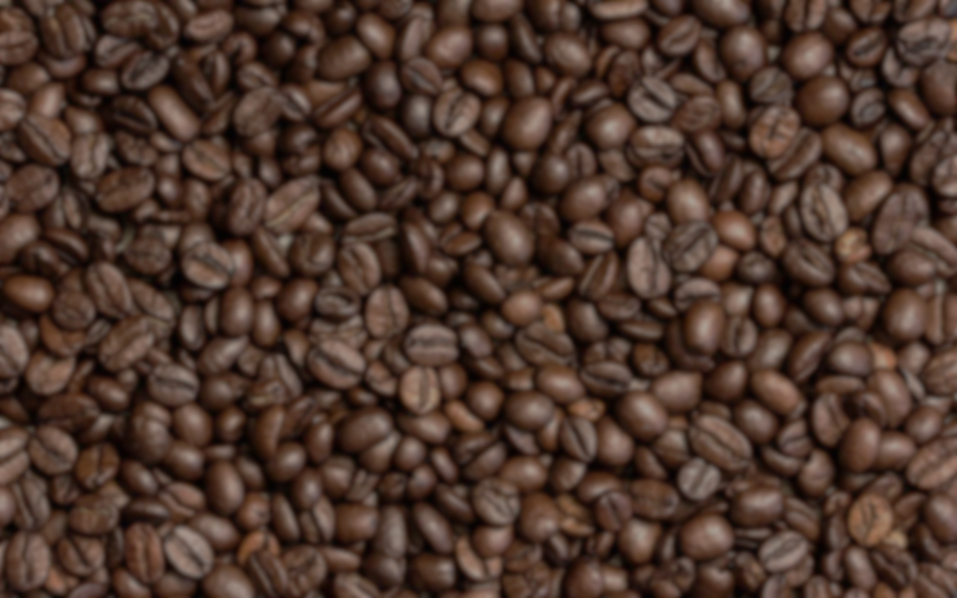
Lucky Coffee Shop
Laszti Kávézó

Slide 2

Customer needs
Make the Website look more modern, since the old one looks outdated.
Make the UI more responsive.
Validate with W3 Schools.

Slide 3
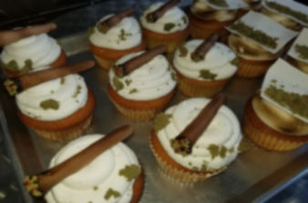
Devices which we used
Trello
Github Pages
Figma
Bootstrap

Slide 4
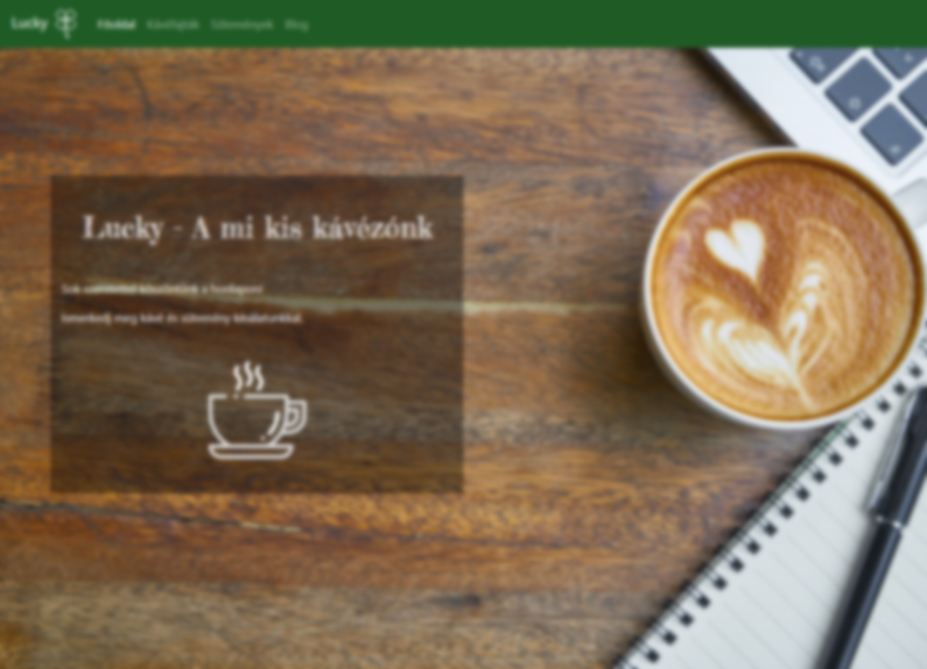
Pages
Main Page
Coffee Types
Desserts
Blog

Slide 5
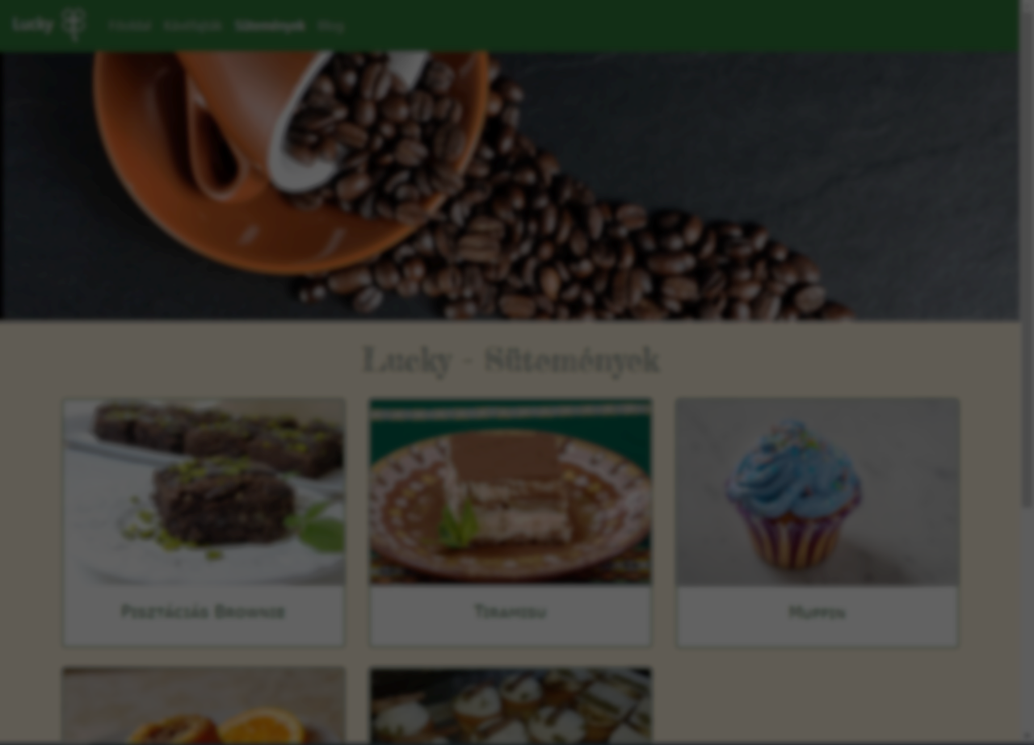

The Footer
This footer was inserted on the bottom of every page, just like this.

Slide 6
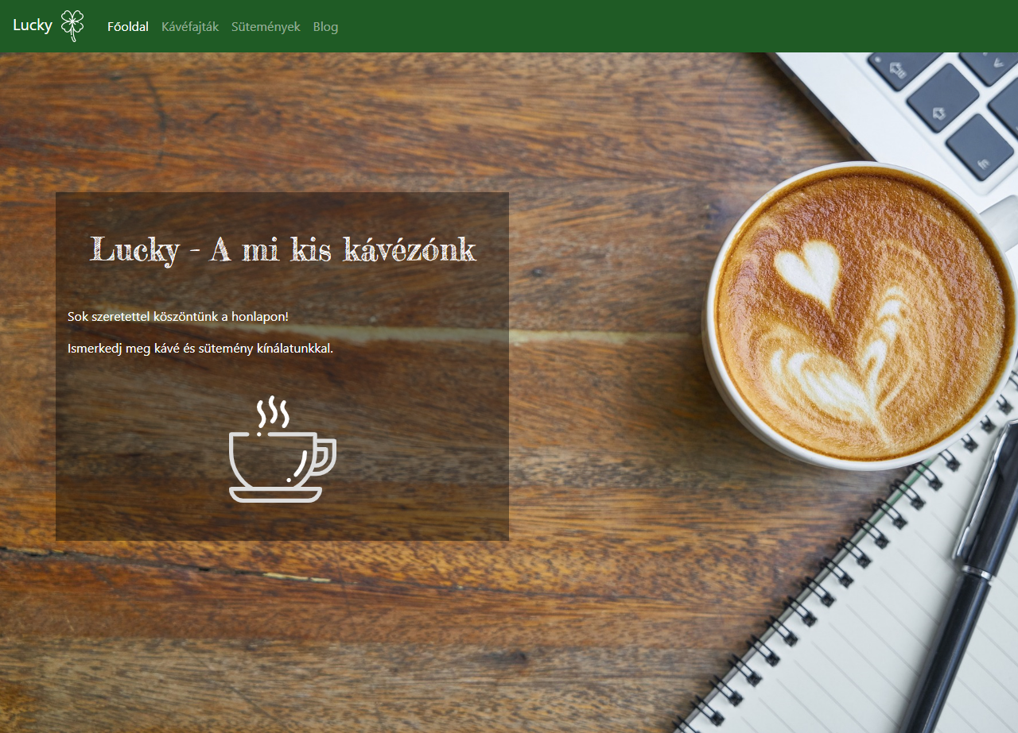
Main Page

Slide 7
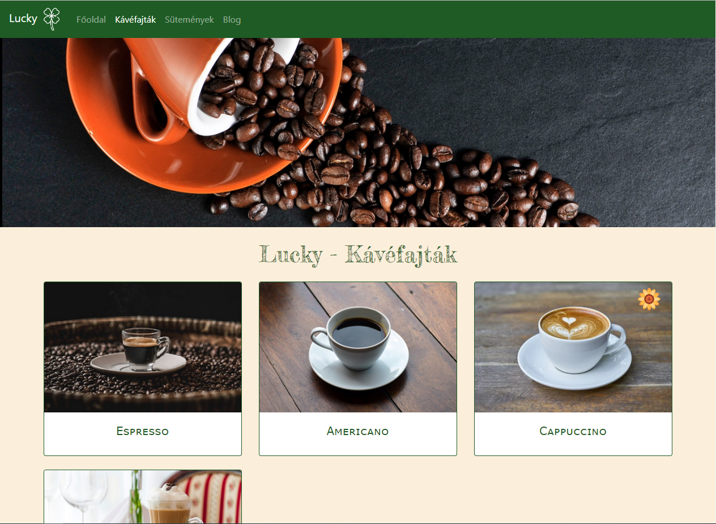
Coffee Types

Slide 8
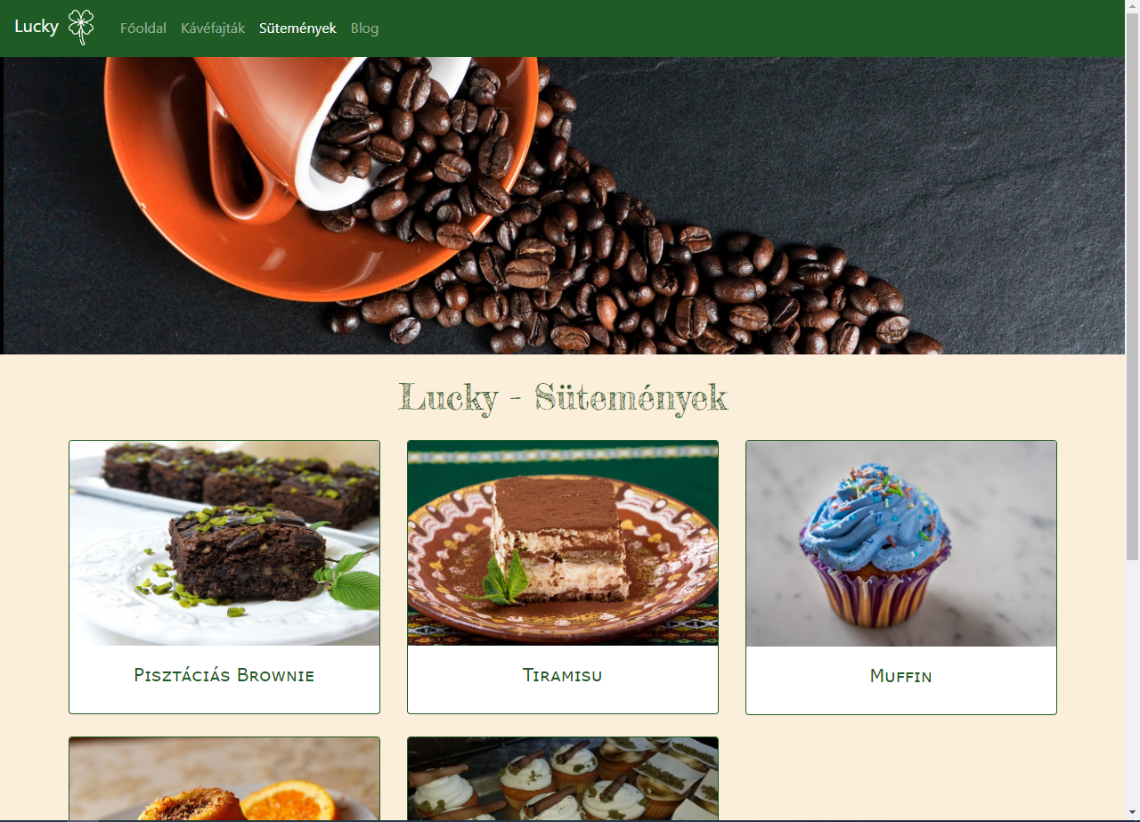
Desserts

Slide 9
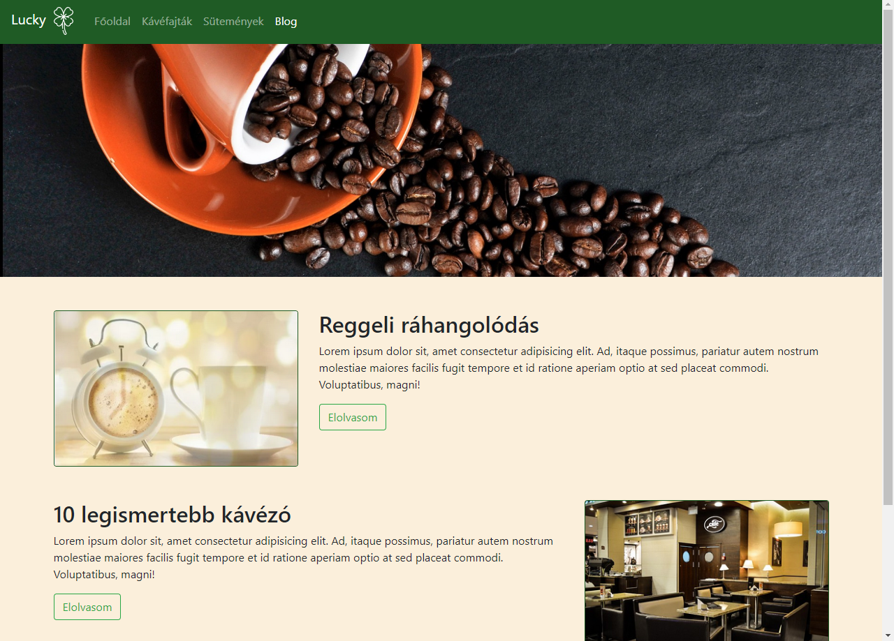
Blog

Slide 10
t
KÖSZ higy megnézted ☺

